Slide 1
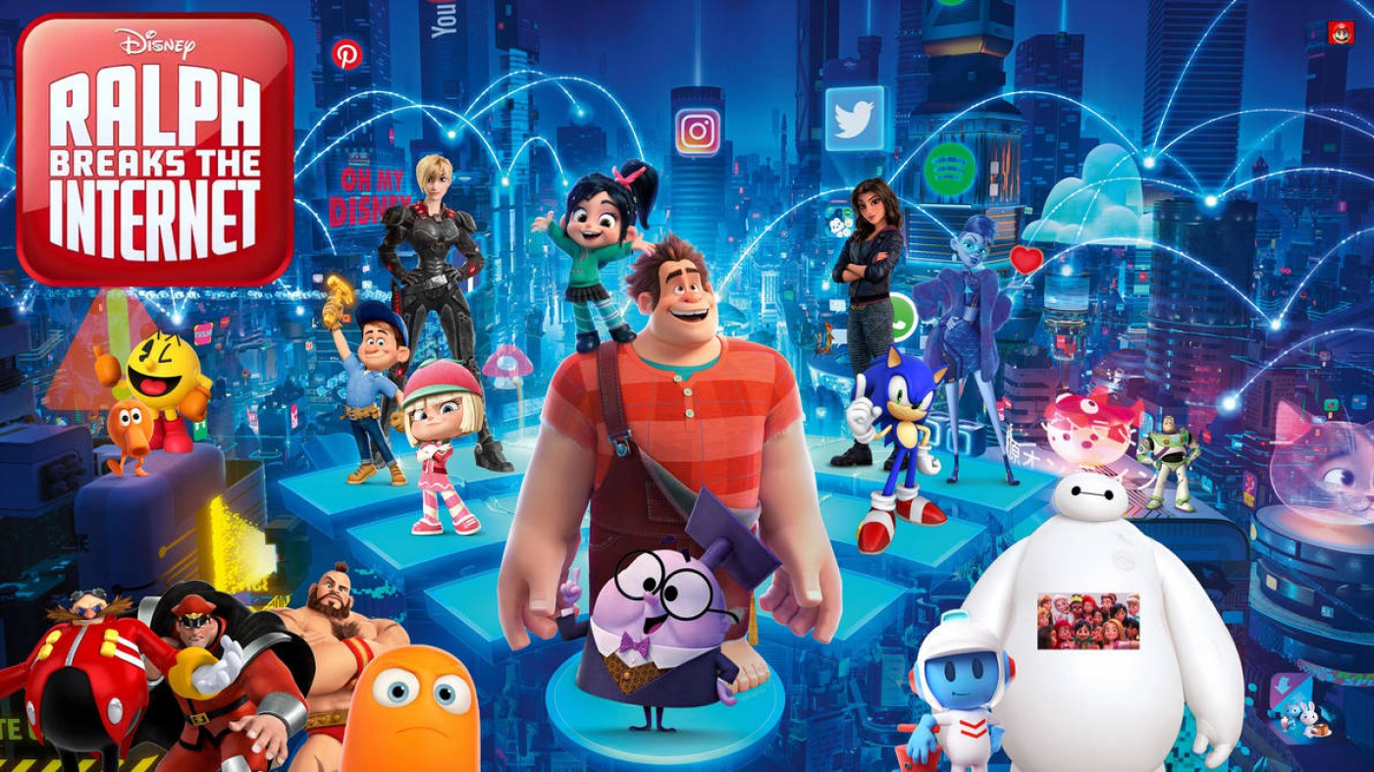
The Accuracies of Ralph Breaks The Internet
5-minute talk

Slide 2
Background
The movie is the sequel to Wreck-It-Ralph
It came out in 2018 (7 years ago)
Directed by Phil Johnston and Rich Moore
Stars John C. Reilly as the title character

Slide 3
Plot
The owner of the arcade they all live in gets Wi-Fi
Because everything is plugged into one extension lead they can all go from each arcade machine and now the Wi-Fi
By going through the router, they end up in the internet which is basically just a massive city (kind of looks like Coruscant from the Star Wars Prequels)
Ralph’s best friend Vanellope decides she likes it in a video game (basically rip-off GTA)
Spoiler Alert

Slide 4
Plot
Ralph doesn’t like this so goes and speaks to a scammer he knows who introduces him to the dark web
Ralph then buys malware of a dude on the dark web and takes it back to Slaughter Race
You can see where this is going

Slide 5
SEE IT IS RELEVANT
Vanellope (as found out in the first movie) has a glitch
The malware scans for vulnerabilities in the code and replicates it
The malware finds Vanellope’s glitchy code and replicates it throughout the game code, so the game stops working
The developers are competent – they have a copy of the original code, so they decide to restart the game and overwrite the wrecked code with the original code

Slide 6
It gets worse
Ralph knows this, so has to get Vanellope out of the game before her code gets destroyed forever
But he also lets the malware escape
The malware starts scanning for a new vulnerability and lands on Ralph mid-break-down
This time – somehow – the malware does something different
It replicates Ralph as millions of insecure Ralph bots causing a denial-of-service attack to the entire internet

Slide 7
Logic <<<
Obviously, we have to remember that this is a Disney film and therefore to resolve the dos Ralph overcomes his insecurities and all the bots disappear into gold dust

Slide 8
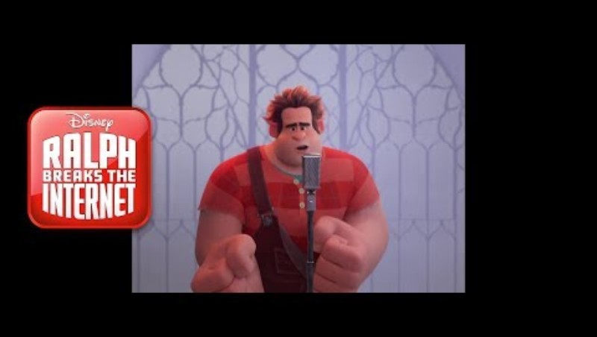
Clip

